Slide 1
Credit One
Understanding Our Customers
Jennifer Meas

Slide 2
the task: investigate customer credit behavior for insights that we can leverage to improve Credit One’s default rates.
Importance: loan defaults affect our profits, creates costly investigation problems, and client rate falls

Slide 3
Our Framework for the Data
Define the goal
Collect and manage data
Build the model
Evaluate and critique the model
Present results and document
Deploy and maintain the model
Reasons behind it: this framework allows us to build an efficient model that can accurately address our task and helps us monitor the situation and adapt to it. The purpose is to solve our loan default problem.

Slide 4
Data Sources
Credit One dataset:
30,000 observations
25 features/variables
Variables we are working with:
Numerical: credit limit, marital status, age, pay amount, pay type, and billing amount
Categorical: sex, education status, and default payment
Response variables are labeled as Yes = 1, No = 0. (e.g. default payment next month ‘Yes’ = 1)
6,636 out of 30,000 observations found customers with default payment

Slide 5
Data Management
Perform an initial exploratory data analysis into the data given from Credit One’s database query.
Using pandas profiling to create an EDA-like report
Using python to explore relationships visually
Applying logistic regression, gradient boosting, KNN, decision trees and random forest models to entail our information and track the performance of them with impressive accuracy/precision scores. This will help our investigation to find insight of factors affecting default rate.

Slide 6
Issues with the Data
Formatting and cleaning the data will essentially drive our model to be successful.
Ridding of duplicates, object-types to keep the data all numeric.
In order to run our regression, object data types will need dealt with.
Rename headers so it is clear in the reports that one of the features is indeed affecting our default rates.

Slide 7


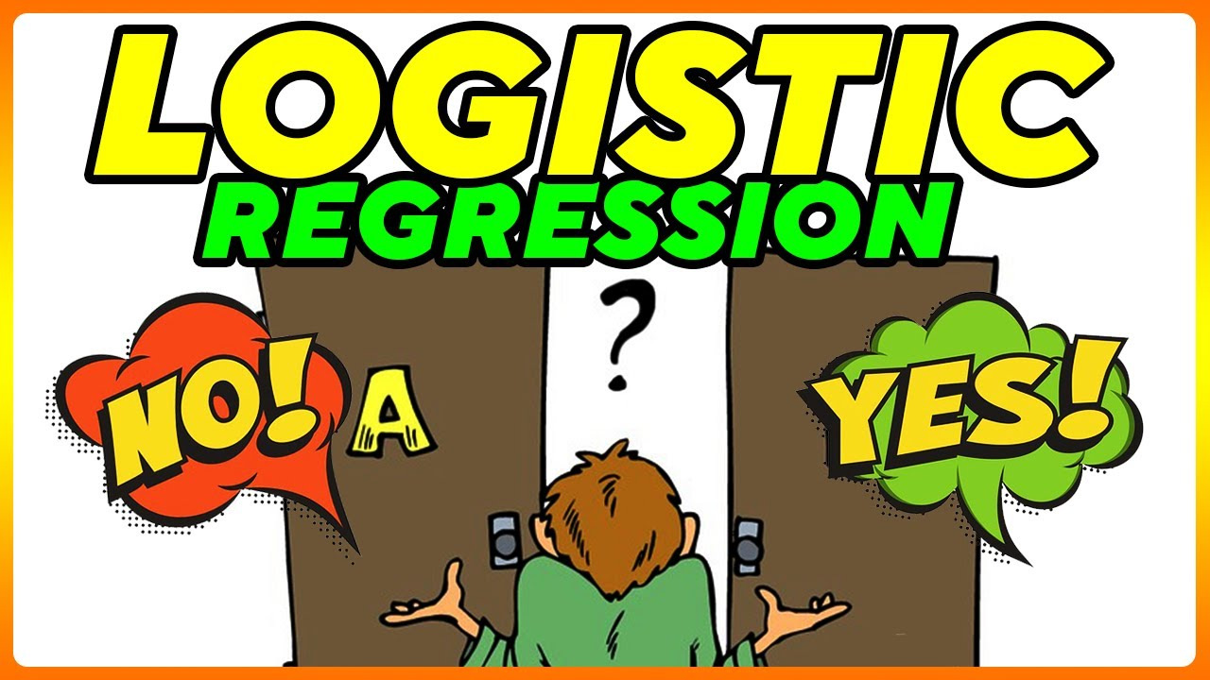



Data Process
Define the goal
Collect and manage data
Build the model
Define the goal
Defaults
= $$$
Deploy and maintain the model
Present the results and document
Evaluate and critique the model

Slide 8
Our Plan of Attack + Insights
Dataset is cleaned, all variables are ready to implement into our models.
All variables in clean dataset provides sufficient and valuable information in our exploratory data analysis.
Insights:
Education level shows significant amount of difference in default rates.
Marital status and age does have impact in education levels.

